Slide 1

SEAT ELECTRONIC CONTROL UNIT
Present By:
1) Tejas Desale (72292474H)
2) Nirbhay Khande (72292569H)
3) Pratik Pawar (72292665M)
Guided By: Dr. P. B. Chopade

Slide 2

INTRODUCTION
A Seat ECU (Electronic Control Unit) is an embedded system in vehicles designed for adjusting the seat position (height, tilt, forward/backward), lumbar support, heating, and sometimes ventilation or massage functions.
The Seat ECU is crucial for enhancing comfort, reducing driver fatigue, and improving safety by enabling precise, customizable seat adjustments and integrating with safety systems in modern vehicles.
The Seat ECU acts as the central processing unit, receiving inputs from the user (buttons or touch controls) and controlling motors, sensors, and actuators accordingly.

Slide 3
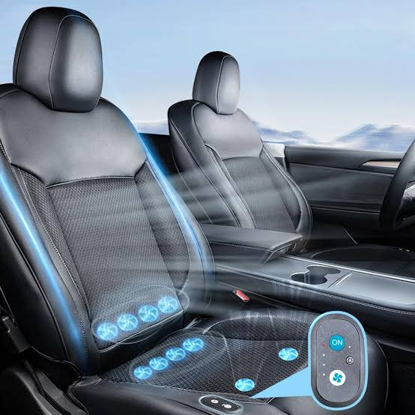
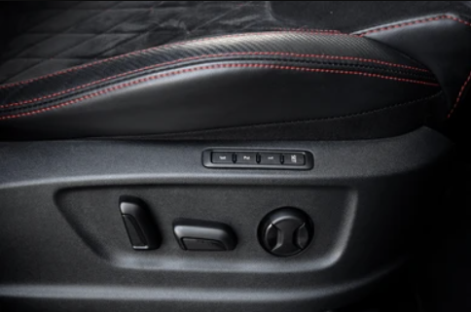

Slide 4
SYSTEM OVERVIEW
System base chip IC : TLE92633BQXV33XUMA2
Motor driver IC : TLE92108-232QX
Microcontroller IC :RENESAS (R7F701686AFP-C )
High side driver : BTS7006-1EPP and BTS70082EPAXUMA1
Low side driver : BTS3011TEATMA1
COMPONENTS
1
2
3
4
5

Slide 5
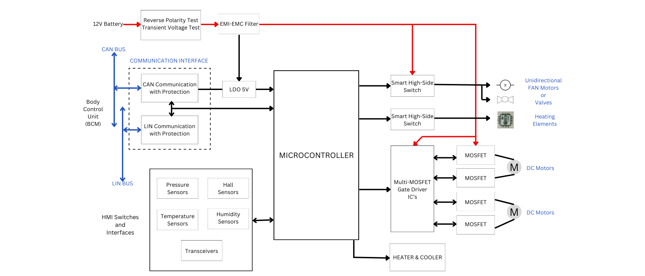
ARCHITECTURE

Slide 6
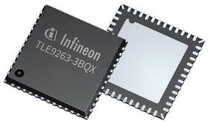
1. System Base Chip IC: TLE92633BQXV33XUMA2
Functionality:
  Acts as a power supply IC and provides voltage regulators (like 5V/3.3V) for powering various ECU components.
  Includes safety features such as watchdog timers, fail-safe outputs, and diagnostic functionality.
Key Features:
  Integrated low-dropout regulators (LDOs).
  CAN and LIN transceivers for communication.
  Multiple voltage regulators to support microcontroller and peripheral components.
Applications:
  Used in automotive ECU designs for controlling power and managing system stability.

Slide 7
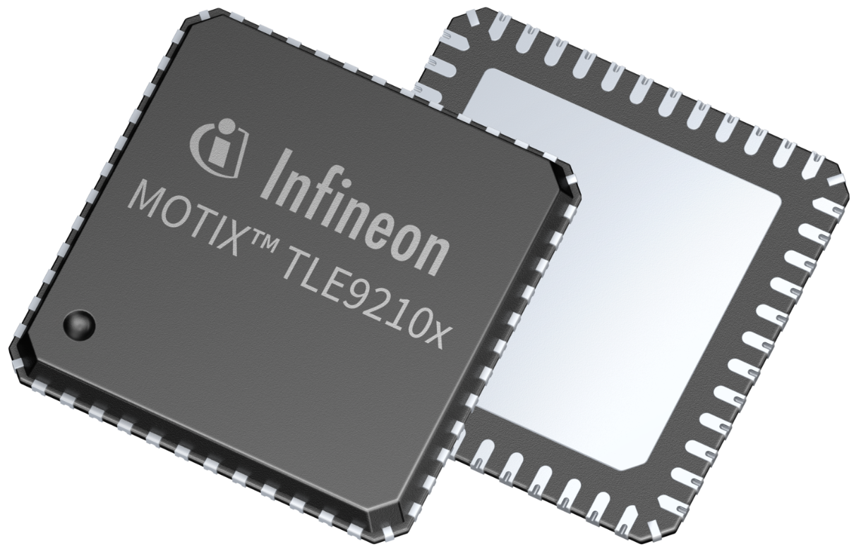
2. Motor Driver IC: TLE92108-232QX
Functionality:
  Controls the motors that adjust the seat position (forward/backward, tilt, height).
  Provides a high level of precision for driving multiple motors simultaneously.
Key Features:
  8 half-bridge outputs for driving up to 8 motors.
  Integrated diagnostics for fault detection (overcurrent, short-circuit protection).
  SPI interface for communication with the microcontroller.
Applications:
  Ideal for controlling DC motors in seat control applications, including memory functions.

Slide 8
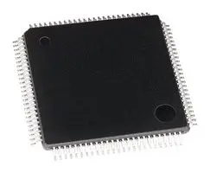
3. Microcontroller IC: RENESAS (R7F701686AFP-C)
Functionality:
  Acts as the brain of the Seat Control ECU, processing inputs from the user interface and sensors.
  Communicates with motor drivers, power supply IC, and high/low side drivers to control seat positioning.
Key Features:
  32-bit ARM Cortex-R5 processor for real-time performance.
  Supports CAN, LIN communication interfaces for automotive networks.
  Multiple GPIOs, ADCs for sensor inputs and actuator control.
Applications:
  Used for controlling complex automotive functions, including seat memory, diagnostics, and safety features.

Slide 9
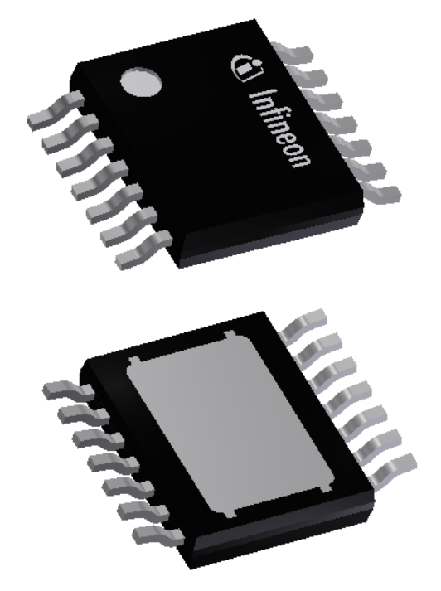
4. High Side Driver: BTS7006-1EPP and BTS70082EPAXUMA1
Functionality:
  Controls the power supplied to the seat motors by switching high-side loads.
  Ensures that the motors are powered safely and efficiently.
Key Features:
  Integrated protection features (overtemperature, short-circuit, overcurrent protection).
  Low RDS(on) for efficient power management.
  Capable of driving resistive, inductive, and capacitive loads.
Applications:
  Used for switching high-side loads to power actuators or motors in seat control applications.

Slide 10
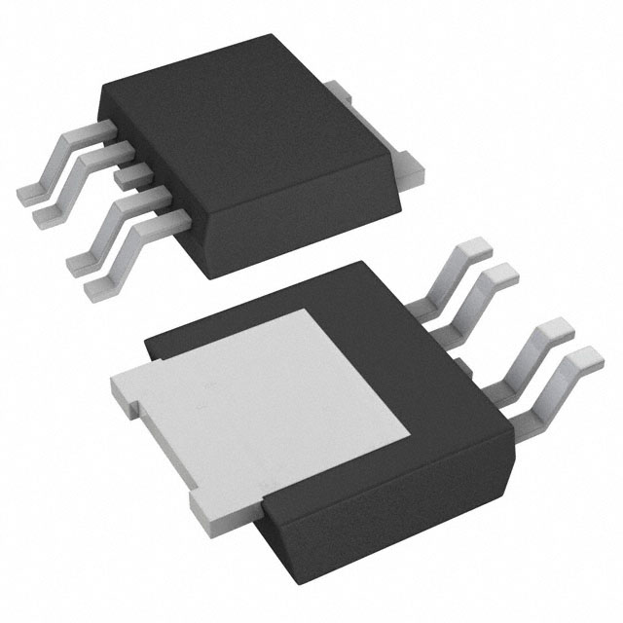
5. Low Side Driver: BTS3011TEATMA1
Functionality:
  Provides control over the ground path of the seat control motors.
  Complements the high-side driver for full H-bridge control of DC motors.
Key Features:
  Overtemperature and overcurrent protection.
  Low RDS(on) for minimal power loss.
  Capable of controlling resistive, inductive, and capacitive loads.
Applications:
  Used in combination with high-side drivers to provide full motor control in seat adjustment mechanisms.

Slide 11
Real-World Examples
Premium vs. Basic Models: Luxury cars like the Mercedes-Benz S-Class offer multi-way power adjustments, memory functions, and climate-controlled seats, while basic models like the Toyota Corolla have limited manual or basic electronic adjustments.
Autonomous Seating Adjustments: In vehicles like the Tesla Model S, seat positions adjust automatically based on driver profiles, offering a personalized experience.
Integration with ADAS: In cars like Volvo, seat adjustments are integrated with ADAS for safety, automatically repositioning the seat during potential collisions or in autonomous driving modes.

Slide 12
Conclusion
The Seat ECU is a critical component in modern vehicles, managing essential functions like seat positioning, lumbar support, heating, and memory settings. It allows for precise, customizable adjustments, which enhance comfort and reduce driver fatigue, particularly during long drives. In premium vehicles, it offers advanced features like massage and climate control, while in basic models, it provides fundamental electronic adjustments.
The importance of the Seat ECU lies in its ability to improve the overall user experience, ensuring comfort and personalization, while also playing a key role in vehicle safety by integrating with ADAS for automatic adjustments in critical situations. Its ability to adapt to various driving conditions and user preferences makes it a vital part of modern automotive design.

Slide 13
Thank You !!

